Slide 1
UTSA Student Branch Phase I Funding Fall 2017
IEEE Central Texas Section
September 16th, 2017
San Marcos, Texas
Branch Advisor: Dr. Paul Morton - Paul.Morton@utsa.edu

Slide 2
Student Branch Overview
Largest active student engineering organization at UTSA
Integral part of College of Engineering student activities
Leadership Team: (14 officers)
Position | Name | Email Address
Chairman | Kasai Omar | k.w.omar@gmail.com
Vice Chairman | Alan Jeanpierre | a.jeanpierre825@gmail.com
HKN President | Ryan Brayton | ryanbrayton95@gmail.com
Robotics Chair | Thomas Kercheville | robotics.utsa@gmail.com
AESS Chair | Garrett Hall | garrett.hall@my.utsa.edu

Slide 3
Past Utilization of CTS Funding Phase I & II Funding accomplishments from 2016:
Student Interest Groups (R5 Robotics) [$800]
Social Engagement (Student Branch) [$200]

Slide 4
Branch Goals Requested amount for Phase I 2017: $1000
Region5 Robotics Competition [$500]
HKN Workshops[$200]
Region5 Circuits Competition [$300]

Slide 5
Branch Goals
Region5 Conference
Compete in both Robotics and Circuits competitions
Increase student presence at conference (~25 attendees)
Global Presence
2017 Automatic Speech Recognition and Understanding Conference (IEEE ASRU) in Okinawa, Japan
2018 Maker Faire Bay Area

Slide 6
Robotics Student Interest Group [$500]
Current Standing
12 people on the team
Primarily focused on Region5 competition
Holding workshops to teach members robotics-related skills
Serving region as constructors of competition play fields

Slide 7
HKN Student Interest Group [$200]
Soldering Workshop
18 soldering stations in need of maintenance
Serve 100+ students annually
Industry Speaking Events
Professional Networking
Membership Benefits

Slide 8
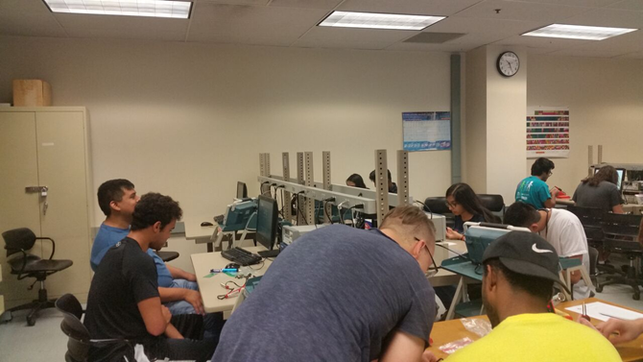
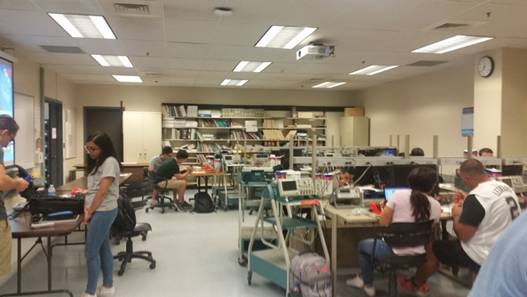
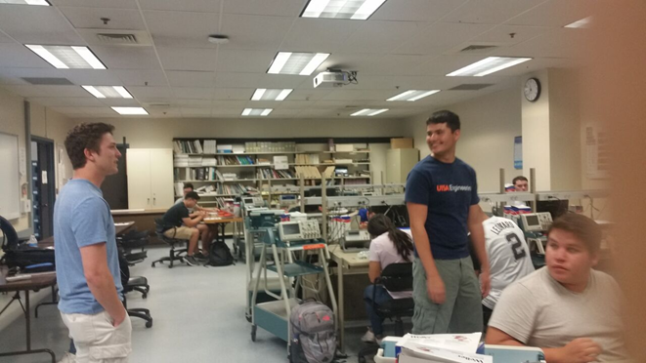
HKN Soldering Workshop

Slide 9
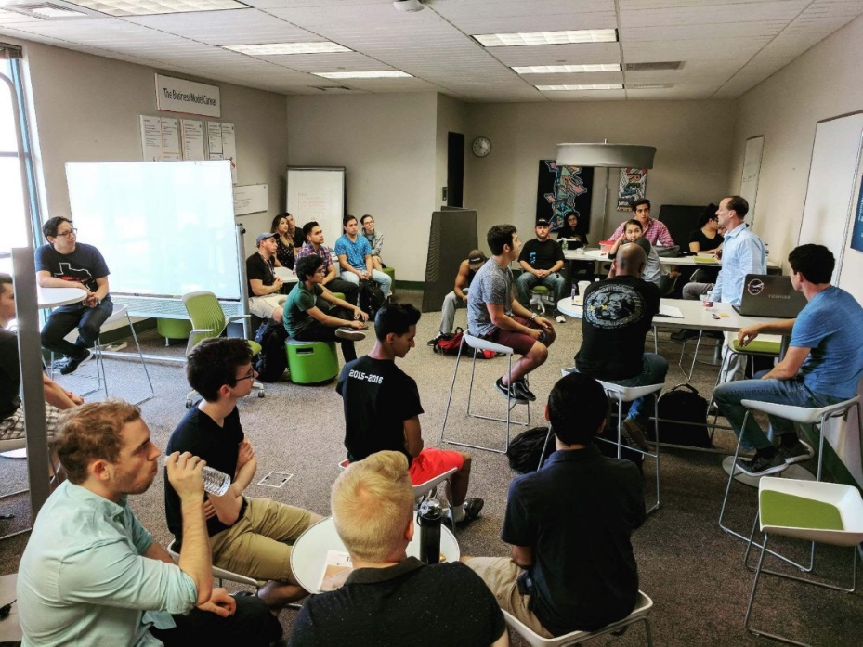
IEEE AESS Represented by Garrett Hall
Developing Officer Base
Monthly Leadership Meetings
Big Idea Group: A multidisciplinary approach to solving real world problems
Clean H₂O
Electrification
Solving Tomorrow’s Problems Today

Slide 10
Branch Goals Requested amount for Phase II 2017: $1500+
Region5 Robotics Competition [$500]
Region5 Circuits Competition [$250]
CTS Student Executive Retreat [$750]

Slide 11
Questions?

